Slide 1
TECH PROGRAMME · DATA ANALYSIS REPORT
APPLICATION
ANALYSIS
Analysis Report · January – March 2026
PREPARED BY
Vivian Okwara

Slide 2
PROJECT OVERVIEW|Tech Programme Report Jan- Mar 2026
Three months of Tech Programme data was examined to understand application patterns, role demand, payment trends, and engagement behaviour.
01
Application Volume
02
Role Performance
Measure total, unique, and repeat application counts across all roles
Identify most and least applied-for roles across 16 categories
03
Timing & Trends
04
Payment Analysis
Analyze activity patterns by month, week, and day of week
Review payment compliance and identify unknown or unpaid records
05
Key Insights
06
Recommendations
What the data tells us
Actions to improve outcomes

Slide 3
KEY METRICS AT A GLANCE
313
were received between January and March 2026
Total Applications
Tuesday
saw the highest weekly traffic, while Virtual Assistant roles attracted 51.2% of all application interest.
Most Active Day
281
confirming active programme engagement.
Unique Applicants
91.2%
Only 1 unpaid application was recorded - but 24 records remain Unknown, requiring follow-up to confirm payment status.
Feb 2026
Payment Rate
alone drove over 73% of all applications - the single most active month, far outpacing January and March.
Peak Month

Slide 4
VISUALIZATION FINDINGS
Tech Programme Data Analysis | June 2026

Slide 5
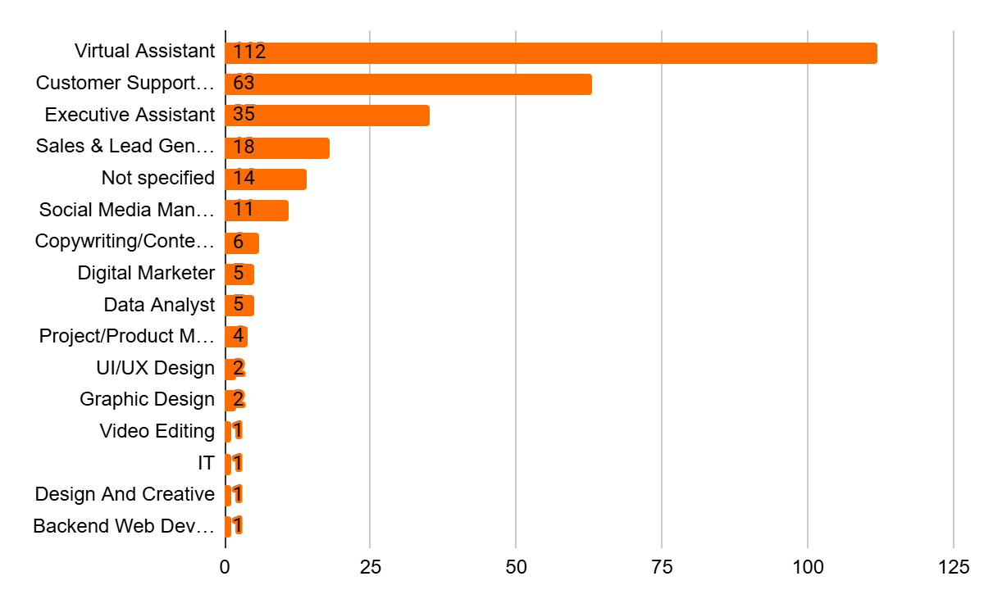
APPLICATION ANALYSIS
Role Distribution
Top Insights
39.9%
Virtual Assistant
22.4%
Customer Support
12.5%
Executive Assistant

Slide 6
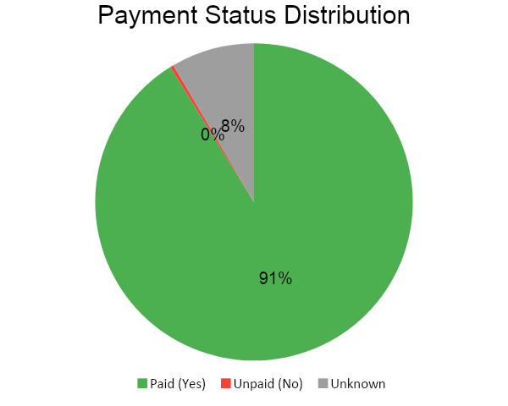
PAYMENT ANALYSIS
281
Confirmed Paid
1
Confirmed Unpaid
24
Unknown Status
91.1%
Payment Rate

Slide 7
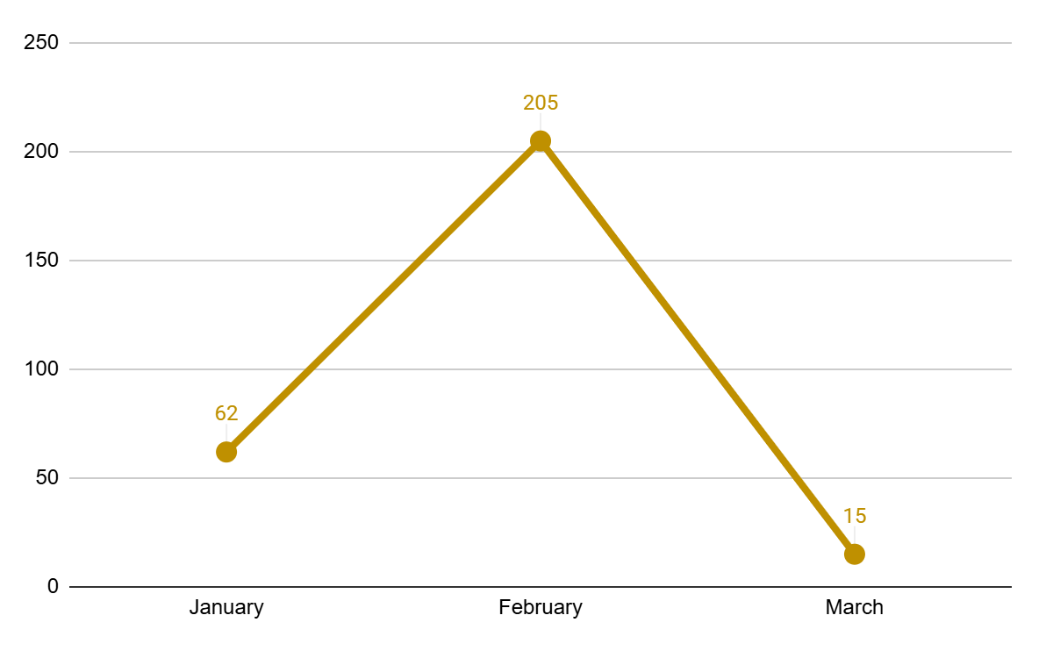
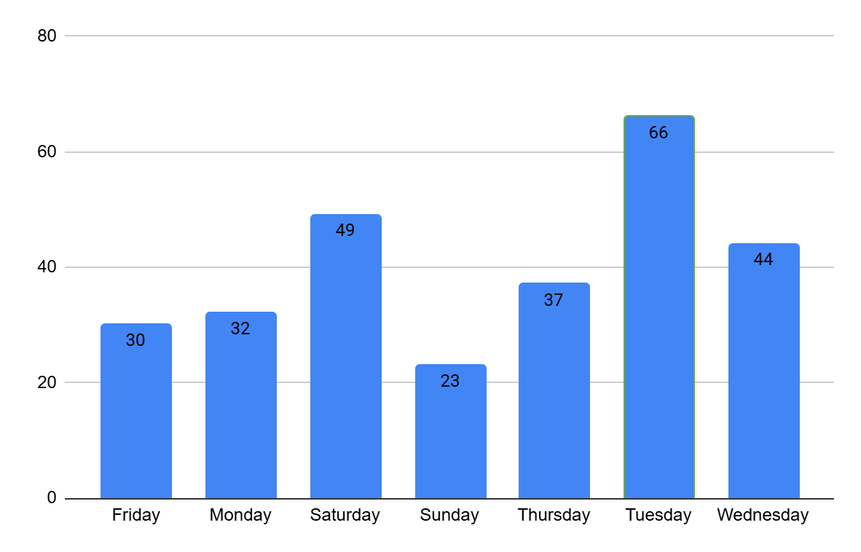
TREND ANALYSIS
Monthly Trend
By Day of Week
Slow Start
February Surge
January recorded only 62 applications - the lowest of the period, averaging 15 per week.
205 applications in February alone -73% of all activity. A critical promotional window.
Sharp Drop-off
Tuesday Rush
March fell to just 15 applications - signalling the intake window closed abruptly.
Tuesdays are peak day with 66 applications. Saturday (49) is the second busiest.

Slide 8
KEY INSIGHTS
VA Roles Dominate
February Peak
39.9% of all applications are for Virtual Assistant roles - the most in-demand position
73% of all applications came in February - a clear promotional spike
Strong Payment
Tuesday Rush
91.1% payment compliance rate shows high applicant commitment
Tuesdays are the busiest day - ideal for announcements and reminders
Low Tech Uptake
Repeat Applicants
UI/UX Design, Graphic Design, IT,Video Editing, Design and Creative and Backend Developer roles received very few applications. Targeted promotion is needed to grow these categories.
30 applicants submitted more than once - needs a deduplication policy

Slide 9
RECOMMENDATIONS
01
Set Deduplication Policy
Limit one active application per person per cohort to keep data clean
02
Resolve Unknown Payments
Follow up on 24 Unknown payment records to confirm or update status
03
Spread Promotions
Stagger campaigns across January and February to avoid feast-or-famine intake
04
Promote Technical Roles
Increase visibility on low performing roles to diversify pool
05
Schedule on Mondays/Tuesdays
Time key communications to align with peak application days

Slide 10
CONCLUSIONS
This analysis reveals a programme with strong demand, healthy payment compliance, and a concentrated intake pattern that can be optimized with the right data-driven strategies.
Strong VA Demand
Virtual Assistant and Customer Support roles together represent 72% of all applications, confirming strong demand for administrative and support-focused professionals.
Seasonal Peak in February
Applications spiked sharply in February and dropped steeply in March. Early January campaigns can capture this intent and extend engagement through the quarter.
Data-Driven Growth Opportunity
With 19 repeat applicants, 24 unconfirmed payments, and several low-uptake roles, targeted re-engagement and better role promotion can significantly improve outcomes.

Slide 11
THANK YOU
Prepared by: Vivian | Tech Programme Data Analysis | June 2026

